Slide 1
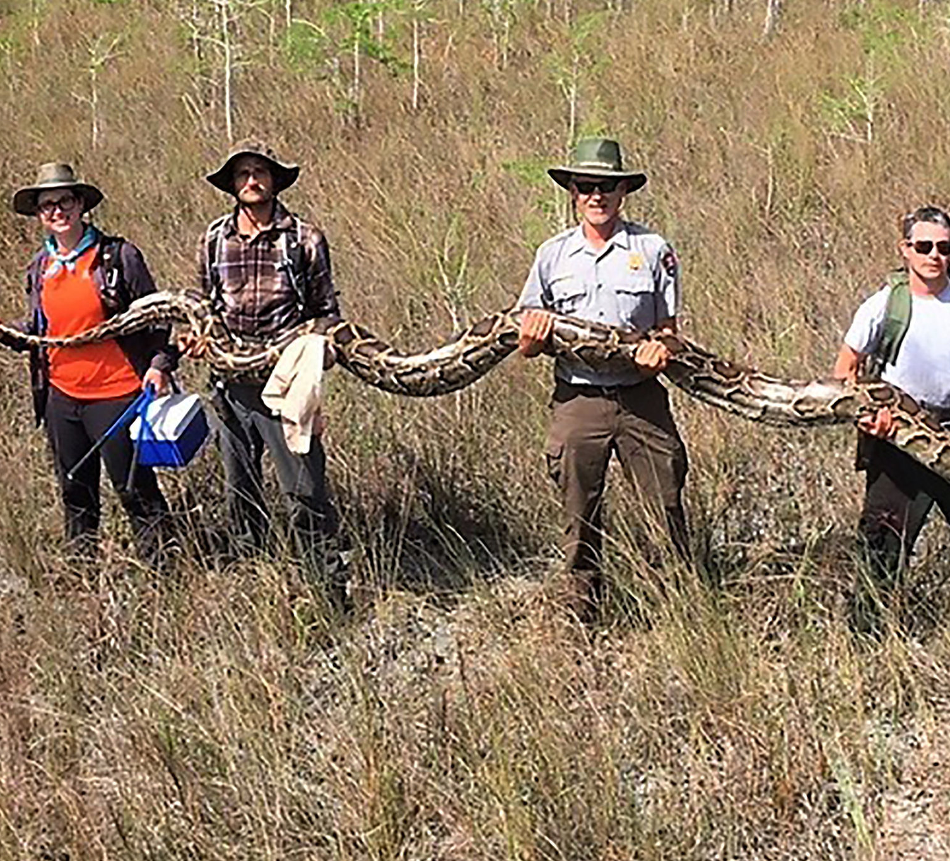
Burmese Python Detection in the Everglades
Gianluca Mangiapane
Presentation 1
MUSA Capstone Spring 2022

Slide 2
What is the Problem?
Burmese Pythons are an invasive species to Southern Florida, since 1979
No natural predators in southern Florida, the perfect living conditions
Elusive and naturally camouflaged, hard to detect to try and find, control, and eradicate

Slide 3
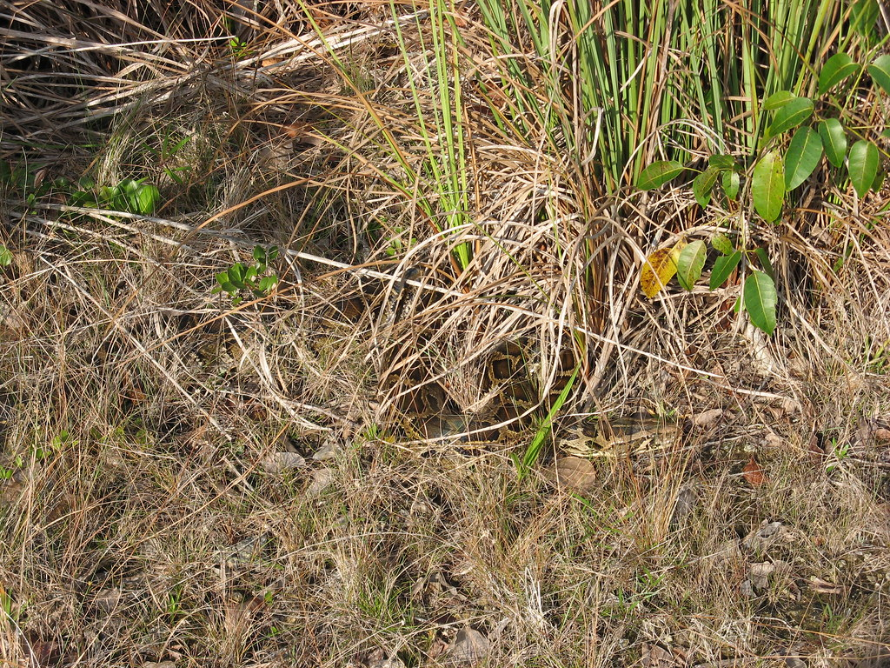

Slide 4
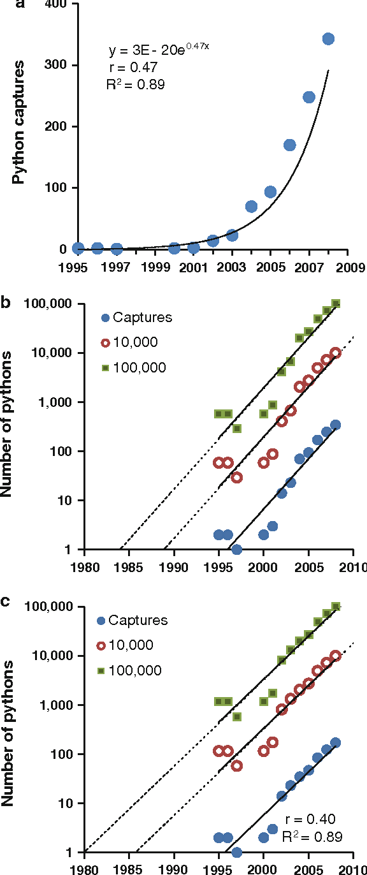
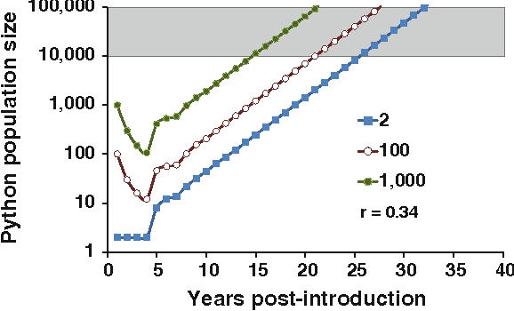
Hatchling Survival Projections
@article{Willson2010IdentifyingPS, title={Identifying plausible scenarios for the establishment of invasive Burmese pythons (Python molurus) in Southern Florida}, author={John D Willson and Michael E. Dorcas and Ray W. Snow}, journal={Biological Invasions}, year={2010}, volume={13}, pages={1493-1504} }

Slide 5
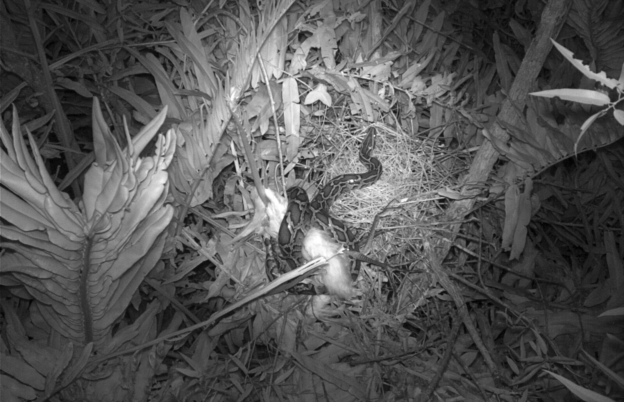
Burmese python and two Great Egret fledglings, captured on trail camera in a wading bird colony in Everglades National Park. Photo: Sophia Orzechowski
2019

Slide 6
Current Detection Methods
Detector Dogs
Remote Sensing
“Judas” snakes
Walkabouts – Camera Traps
Environmental DNA
A lot of sightings/recordings are drivers on roads as well

Slide 7
Goal: Create a Model that can help with detecting most likely presence
Are there relationships among features to help guide detection resources?

Slide 8
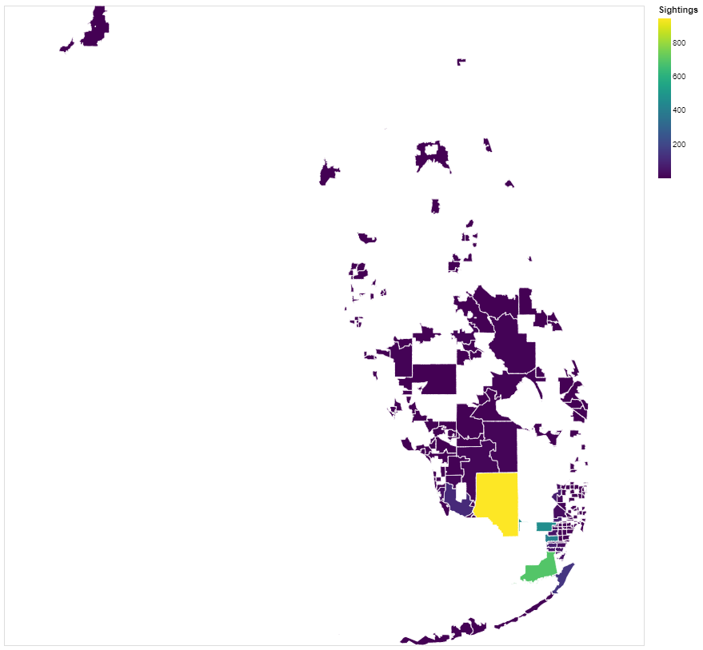
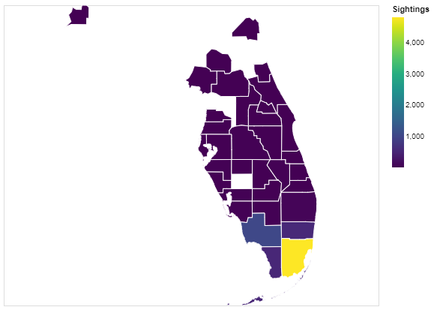

Slide 9
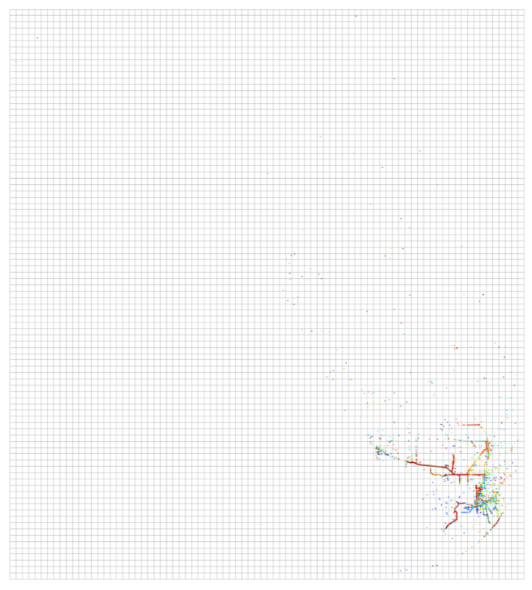
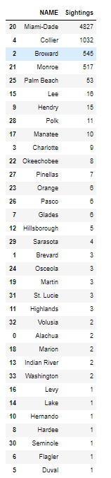
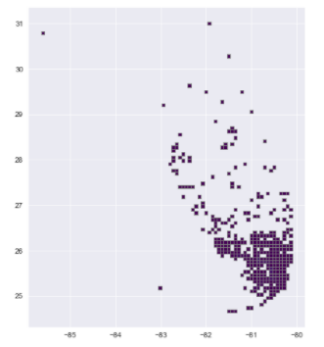

Slide 10
Datasets – aka features
Python sightings
Visual Sightings, GPS trackers, Remote Sensing
Flowing Waters and Stream sites
Lakes
Bird Habitats 2003
Designated Bird Sanctuaries
Eagle Nesting Sites
Bird Nests 2000
Land Mammal Habitation areas
Shorebird habitats
Snowy Plover Nests
Wading Bird Colonies
Land Use Cover
Temperature/Solar Radiation in TIF format – still need to review
Environmental DNA sampling sites

Slide 11
NEXT STEPS?
1. Feature Engineer
How to account for human recordings? How many humans per sighting, and add that in?
Workable grid system for the model, might split Florida up into different sections to assess
Account for urban build up
What features am I missing or not thinking of?
Stuck with the concept of how to make this a workable model?
-How will this be more useful than environmental DNA sampling?
-Can we contain the northern and mid-region counties?
QUESTIONS?

